Slide 1
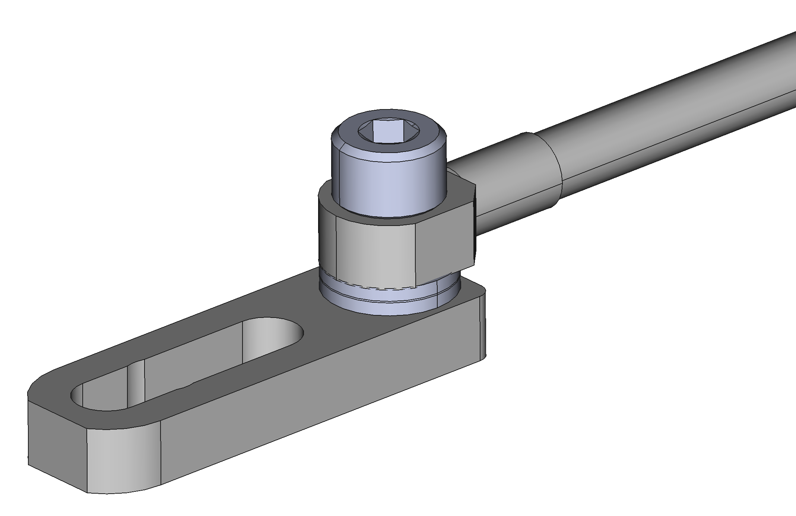
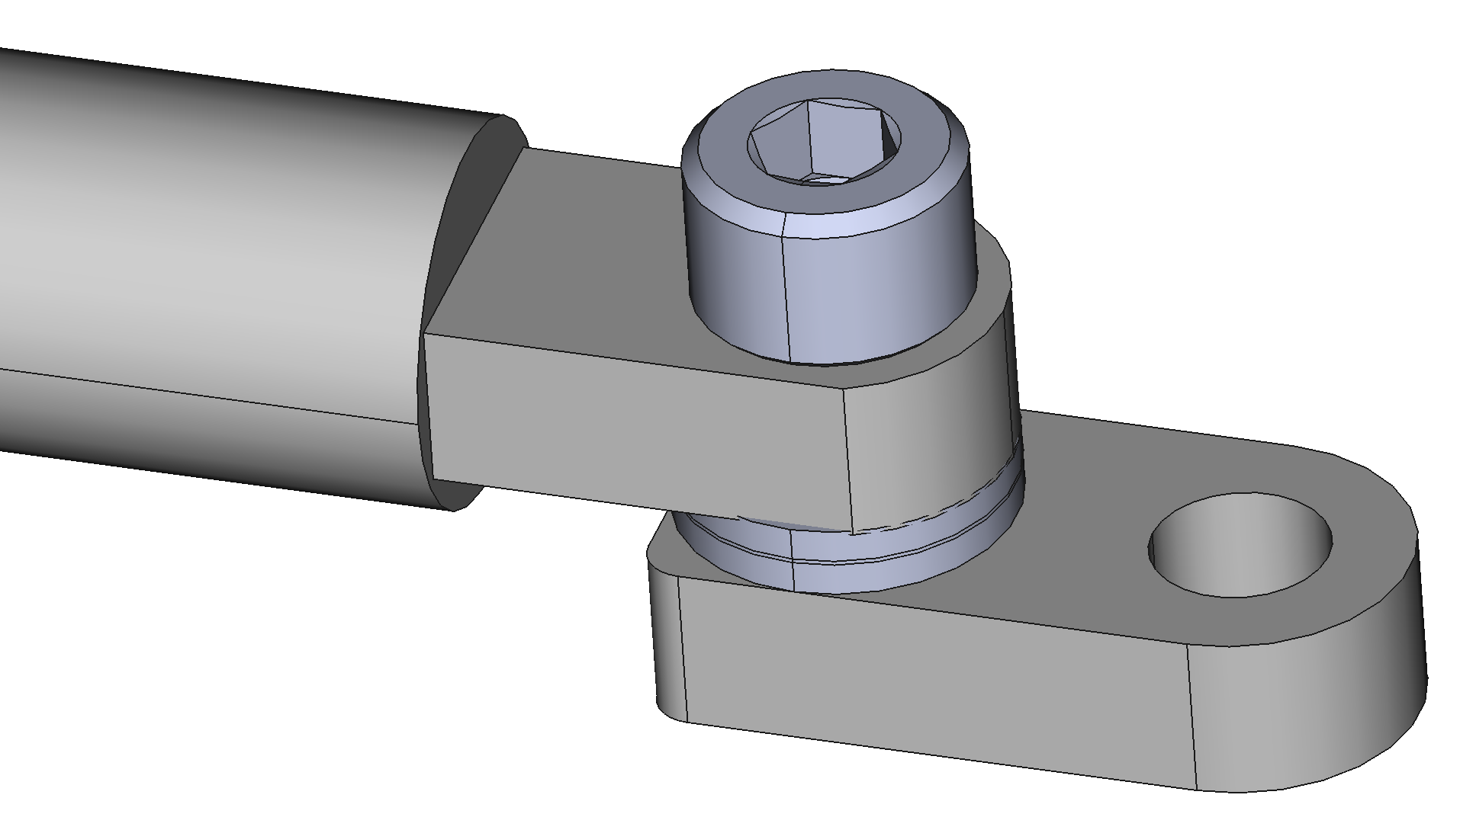

Slide 2
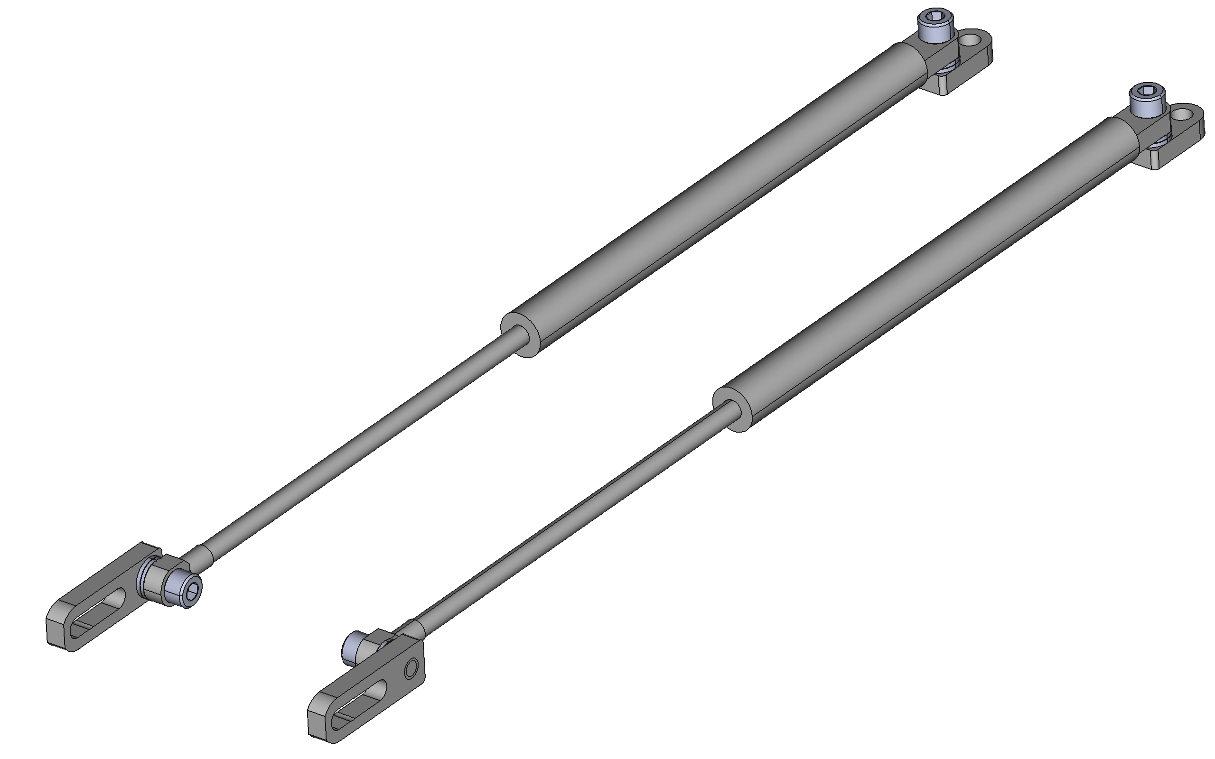
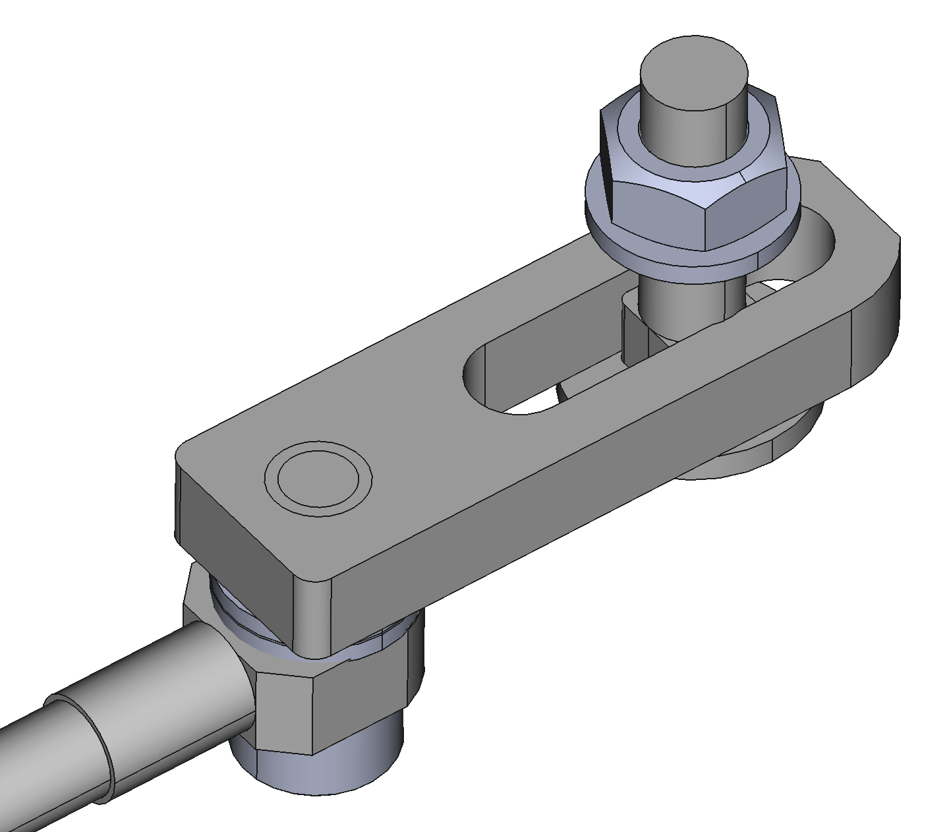
“Coach”/ “carriage” bolt used to affix slotted coupling tabs to side panels
TL
TR
CR
CL

Slide 3
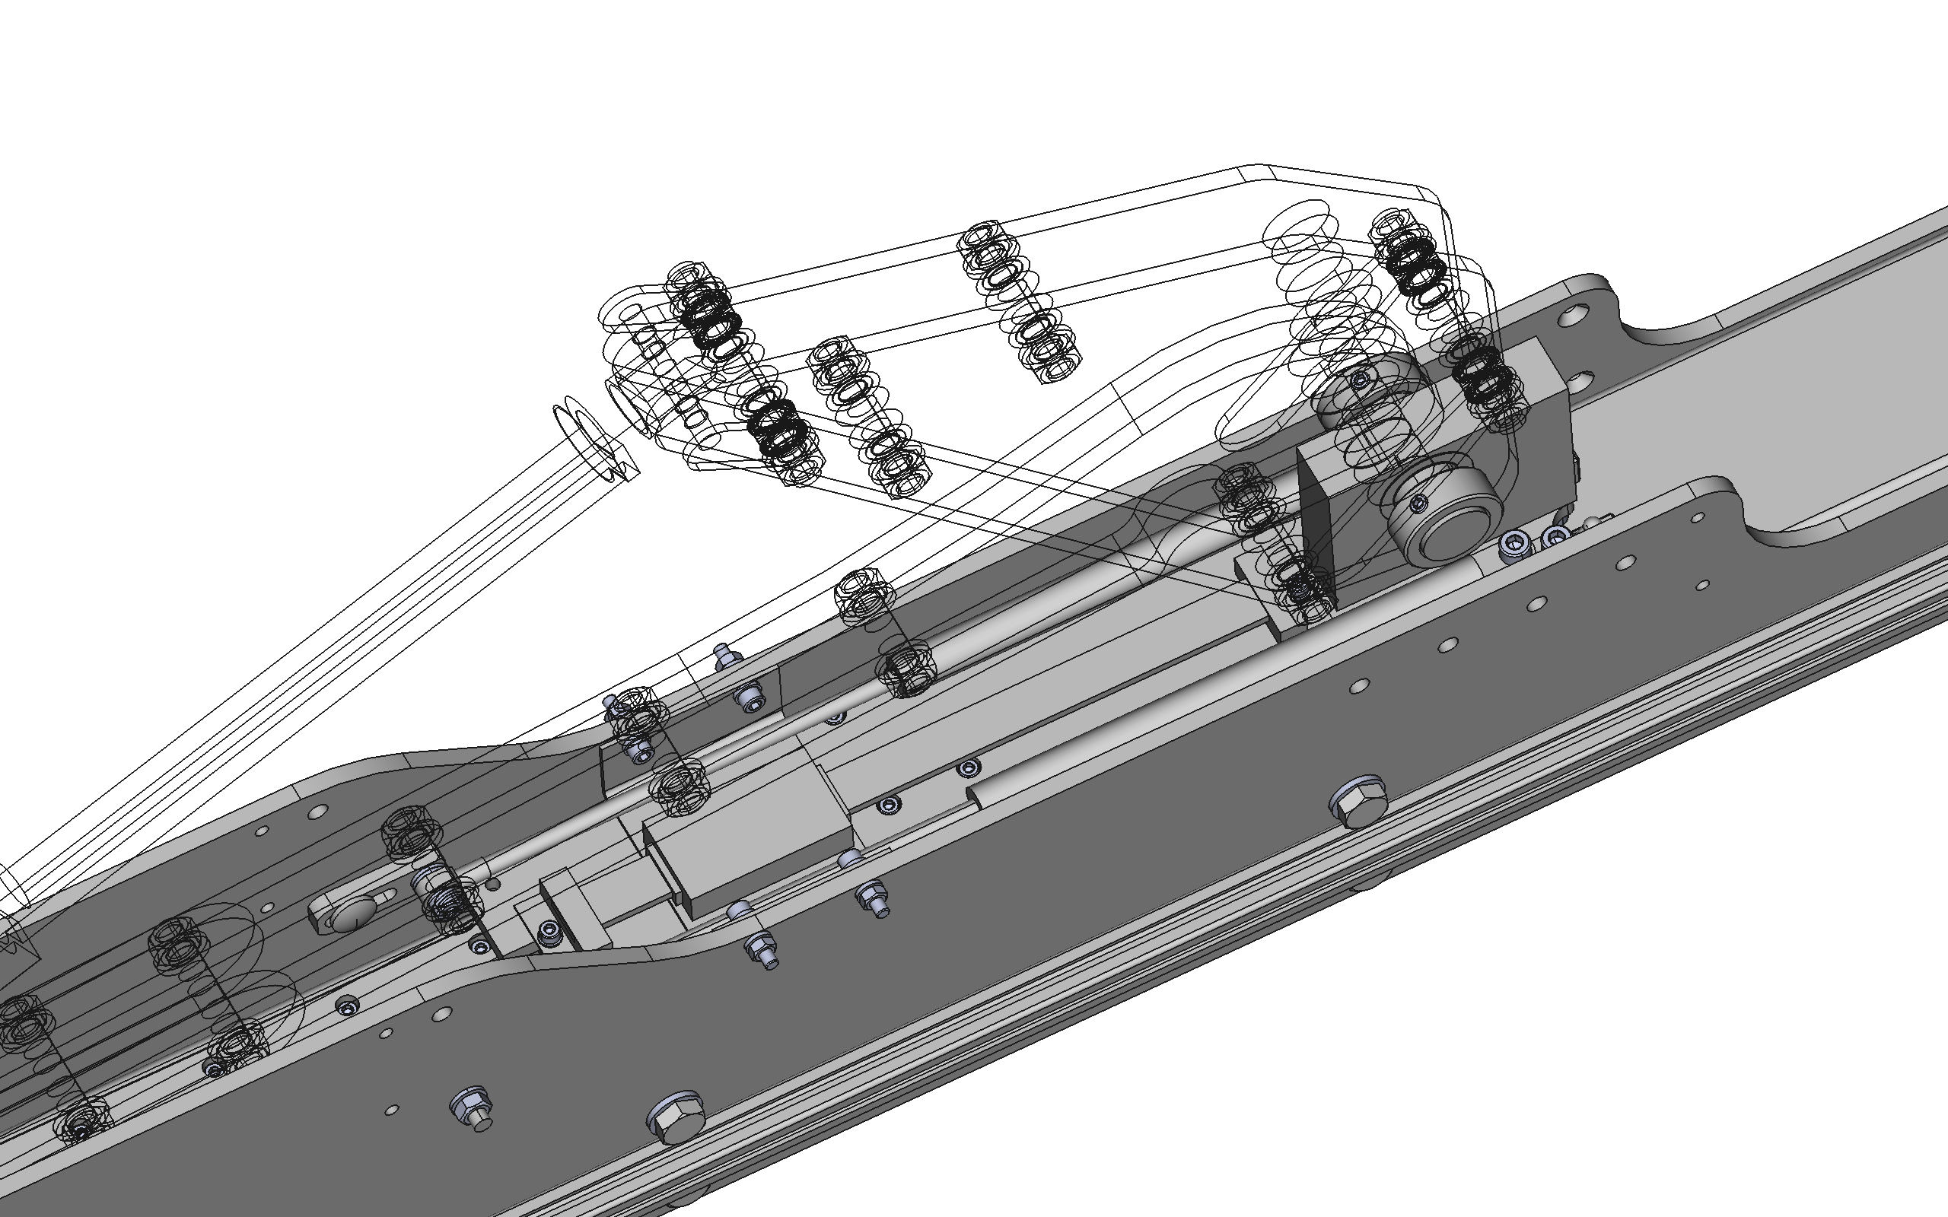
Actuator fully retracted to mount gas springs
Slotted coupling tabs mounted via these holes in side panels for any tensile test range
Non-slotted coupling tabs mounted via these holes in coupling plate for tensile tests

Slide 4
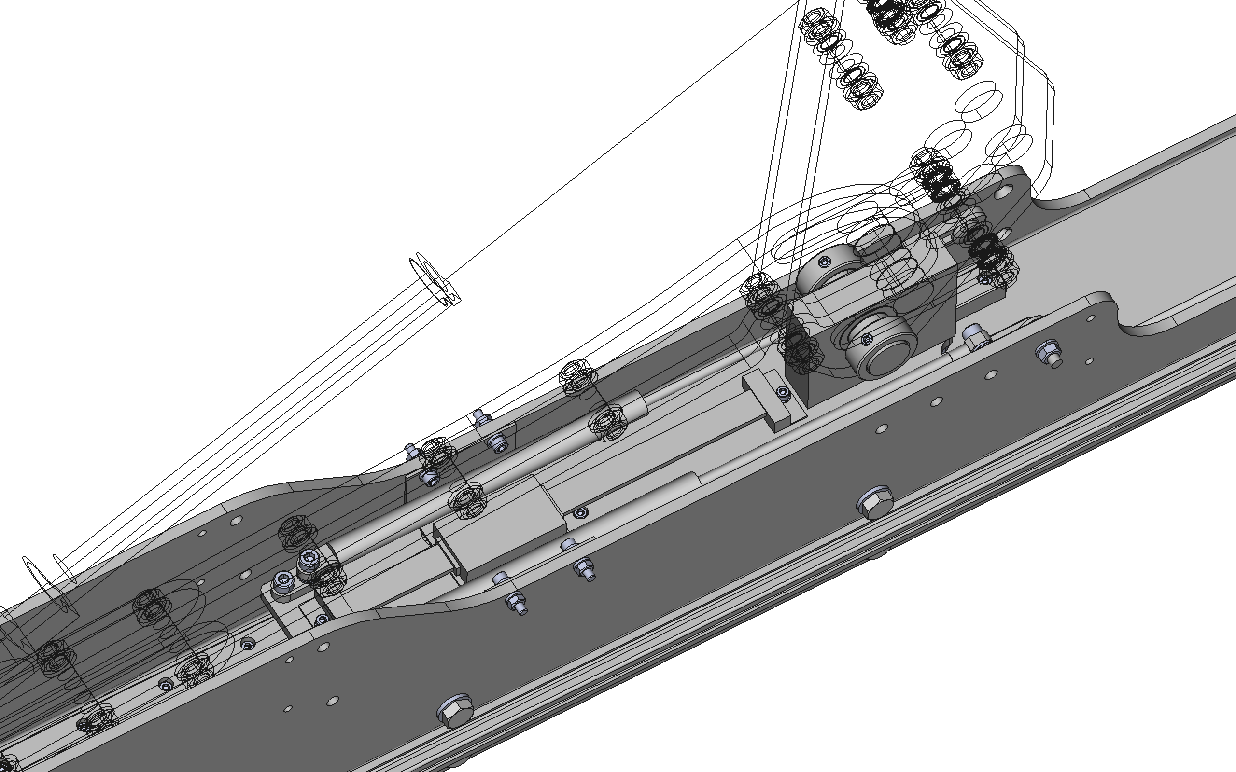
Non-slotted coupling tabs mounted via these holes in coupling plate for compression tests
Actuator fully extended to mount gas springs
40mm
80mm
120mm
160mm
Slotted coupling tabs mounted via these holes in side panels for compression test ranges shown

